Slide 1
Project
Presentation
Solution and approach to the Klaveness case project

Slide 2
TOC
Overview
Introducing: Klaveness Case Project
Understanding the problem
View supplier contracts
Add new supplier contract
Edit supplier contract
Delete a supplier contract
Project objective
Project timeline: 01/11/21 - 04/11/21

Slide 3
Overview
The presentation is about the case project provided by Klaveness Digital for the interview process.
The solution to the problem involved:
Initial system architecture planning
Choice of technologies
Coding the REST API + GUI
Testing the functionalities manually

Slide 4
Understanding the problems
01
What is the general architecture of the solution? (How many components and how do they communicate?)
02
Why did you select the libraries you selected?
03
How can you add any sort of type safety to the application?
04
How did you proceed to test and verify the correctness of the solution?

Slide 5
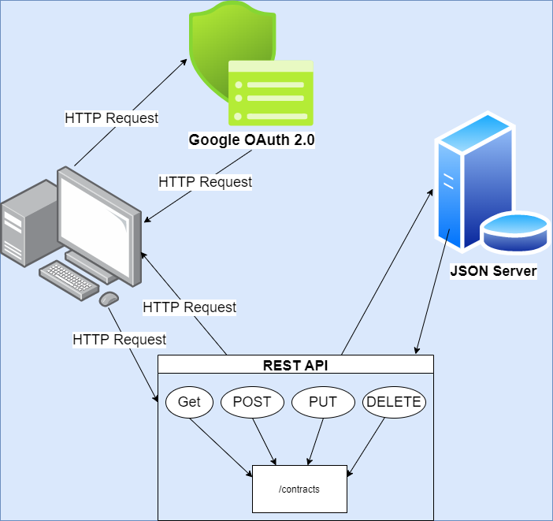
What is the general architecture of the solution? (How many components and how do they communicate?)
Architecture Overview
The web application uses Google’s OAuth 2.0 to authenticate the client
Once authenticated, client has persistent access to the web interface to perform CRUD operation via HTTPs over a REST api
The api communicates with the JSON Server that manipulates the data based on the action
User logs out of the system to get back to the login page
Components used in GUI:
Login component - to authenticate users in order to use the application
Contracts Dashboard - lists all available contracts in the system in the form of cards
Search Component- to search a contact by Company name
Modal Component - reusable for both adding and editing a contract
Reusable form components (input, datepickers, select) - used to create the add and edit item form

Slide 6
Why did you select the libraries you selected?
Backend (API) libraries used:
Json-server (Used to serve and manipulate the data stored in a json file )
Frontend libraries used:
React + Redux + Redux Toolkit (JS Framework for GUI development)
React Google Login (for using google authentication services as a mode of authentication for the application)
React Bootstrap + React Material UI (CSS Framework for rapid prototyping. A mix was needed to use out of the box UI components that each of them provides, which was found useful for prototyping)
Moment (to handle date-time formatting)
Formik + Yup (for form validation and submission)

Slide 7
How can you add any sort of type safety to the application?
Initially, the backend api was thought to be developed with a proper DB design with JWT token based authentication that would protect the API routes.
Due to time constraint and the simplicity of the project, Google OAuth 2.0 was used to authenticate the user and have access to the application.
On the frontend side, since it is authenticated by google authentication, no routing is implemented so that the application is protected.
Furthermore, for adding, editing or deleting new item, modals are used so that no extra route is necessary. This was a design choice, considering the simplicity of the task.

Slide 8
How did you proceed to test and verify the correctness of the solution?
Initially, I thought to implement JEST for automation testing, but due to time constraint and adding extra complexity to the project, it was scrapped
Manual testing was conducting on the following steps:
User can login with google and view the dashboard of all contract cards
Unauthorized users should only see the login page
Forced routing on web address bar should take the user to the login page, if user is not logged in
Application is responsive on different screen size and devices
Searching by name should show the searched item card, if an item is not found a blank screen is shown
User can edit an existing contract using the modal form
Form validation should work before submitting the data to the REST API
User can add a new contract item
User can delete an item from the edit form window successfully
Create, Read, Edit, Delete (CRUD) operations should instantly show effect on the contracts dashboard/list without the refreshing the application

Slide 9
Additional thoughts and notes
Given more time:
I would create a proper DB and backend service with authentication for more security layer
Add feedback, in the GUI when the user performs CRUD operation using the application
Make the GUI look more appealing, without impacting performance
Add routing with the application to implement
Detailed view of a contract
Dashboard with user statistics, notification and contracts overview
Notification about contracts that are close to its expiration date and renewal negotiation date
User management profile and personalization
Implementat validate login in the date-time of start, end and renew period

Slide 10

Thank you!
The project was fun to solve from design to development. It gave me the chance to implement agile development, planning each functionality, developing and testing and finally integrate is all together.

